Slide 1
Investigating algorithms for the unsupervised alignment of conceptual systems
Kaarina Aho | Supervisors: Brett Roads & Brad Love | EcoBrain DTP Rotation 2

Slide 2
Concept learning background
Context
Supervised learning
Unsupervised learning
Children can learn hundreds of concepts in their first years
(Fenson et al, 1994)
No consensus on the underlying mechanism
Explicit instruction plays a role
But explicit concept labelling is ambiguous, e.g the Gavagai problem
(Quine, 1960)
Statistical regularities may be leveraged to learn concepts unsupervised
(Younger and Cohen, 1986; Chambers et al, 2003)

Slide 3
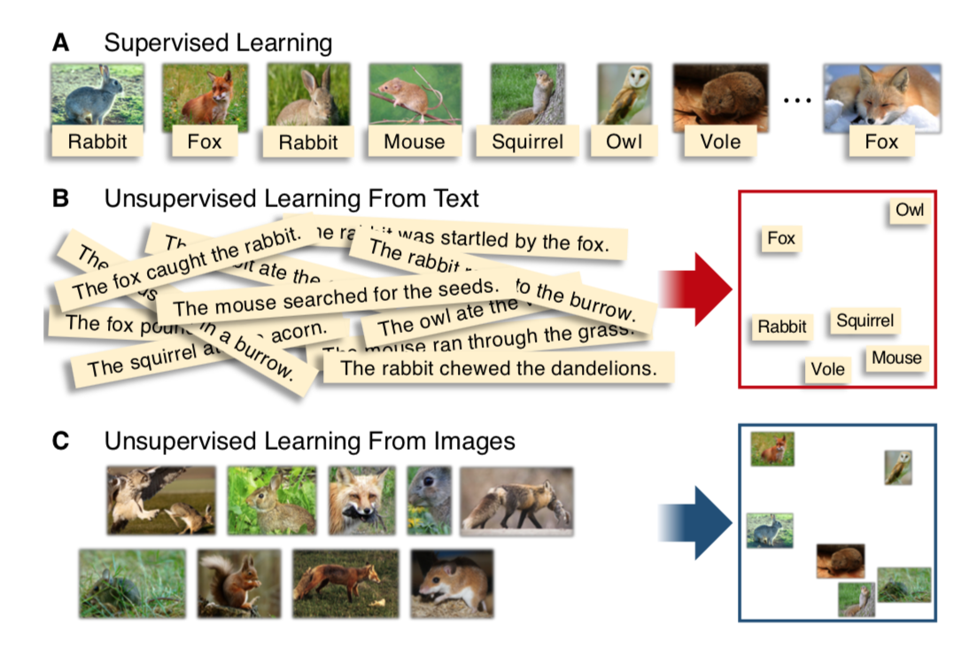
Conceptual system alignment
Learning as the unsupervised alignment of conceptual systems
Roads, B.D. & Love, B.C. (2020), Nature Machine Intelligence
Concepts are experienced in multiple modalities (e.g vision, text and audio)
Similarity relationships are the same across modalities

Slide 4
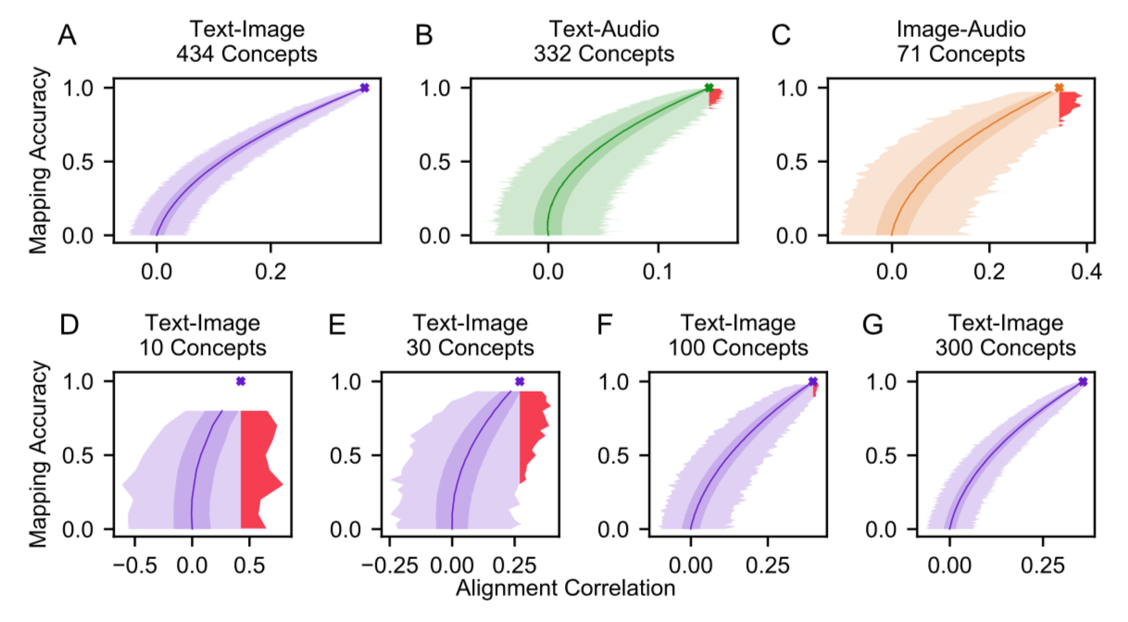
Unsupervised alignment is possible in principle
Each mapping can be summarized by an alignment correlation, which has been shown to correlate with mapping accuracy between systems
Roads and Love (2020)

Slide 5
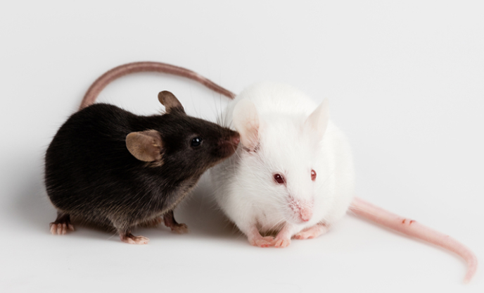
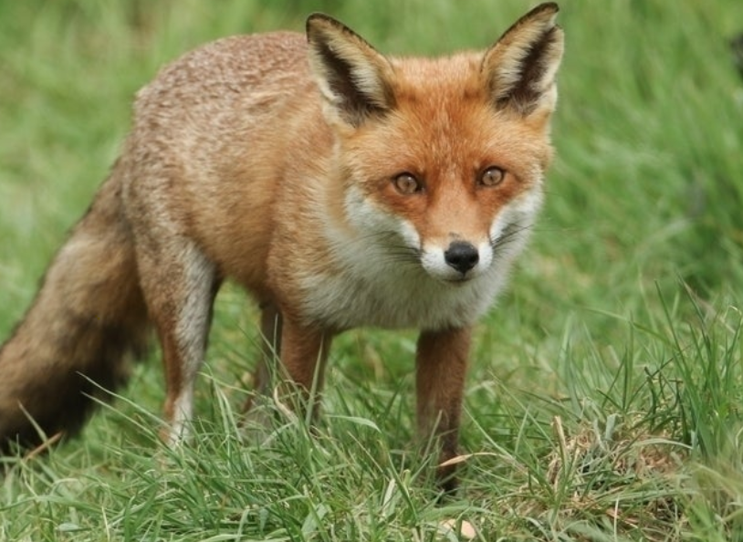
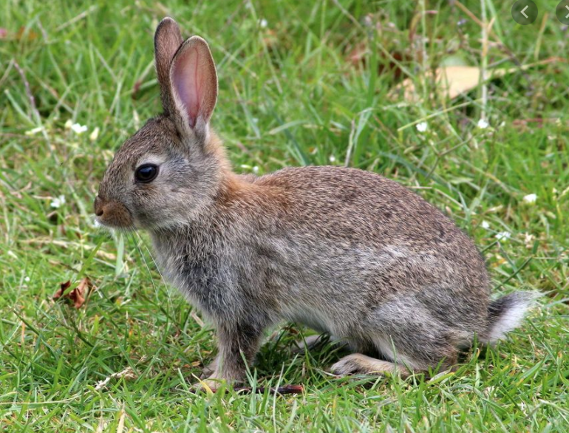
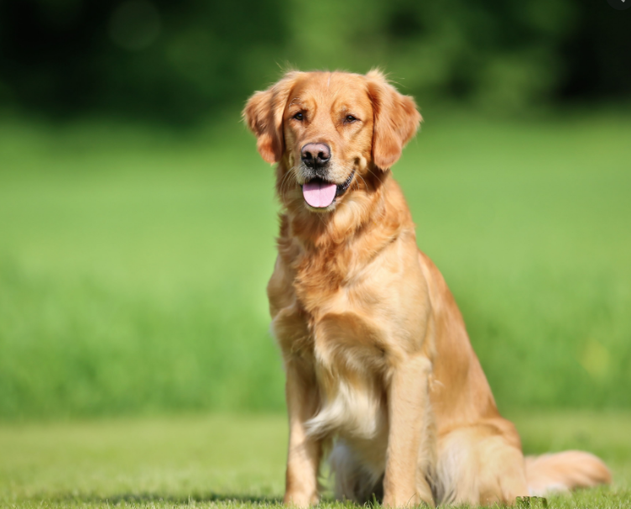
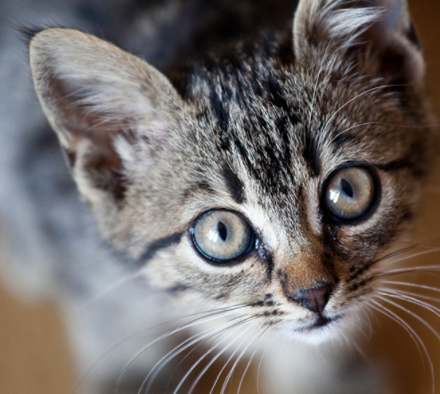
The aim of the current project
There are N! possible mappings, where N is the number of concepts under examination
Problem: how can we efficiently find the correct mapping?
Fox
Mouse
Images
Model
Text
Rabbit
Dog
Cat
Fox
Text
Model
Images
Mouse
Rabbit
Dog
Cat
Aim: Find a model that can efficiently map between modalities an unsupervised fashion

Slide 6
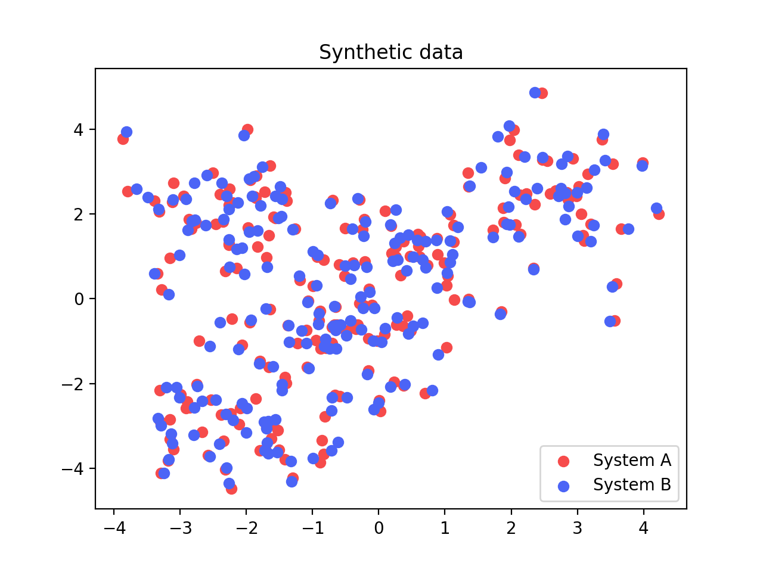
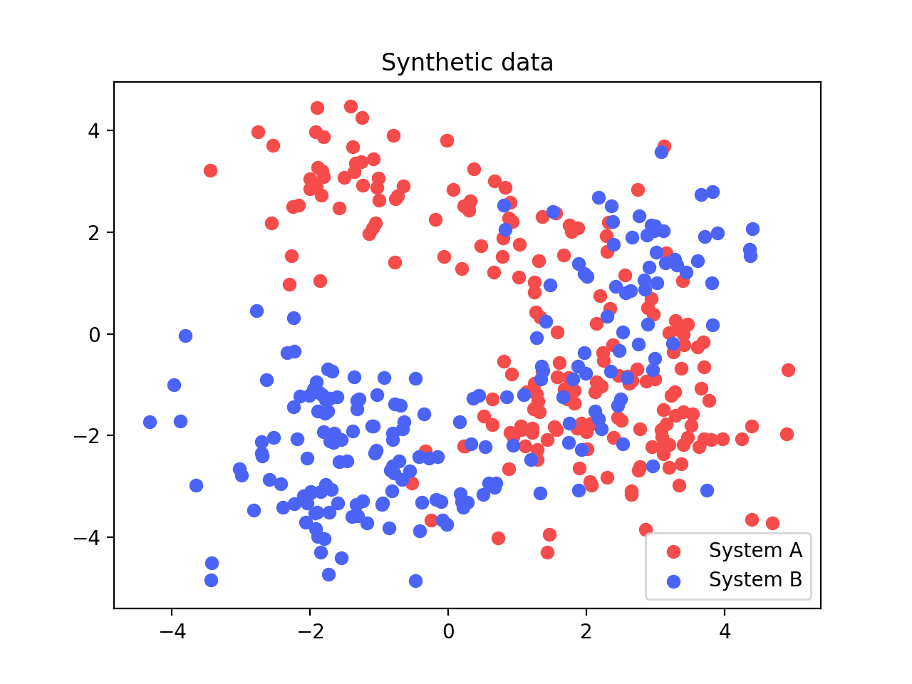
Synthetic problem setup
+ Noise
+ Noise, + Rotation

Slide 7
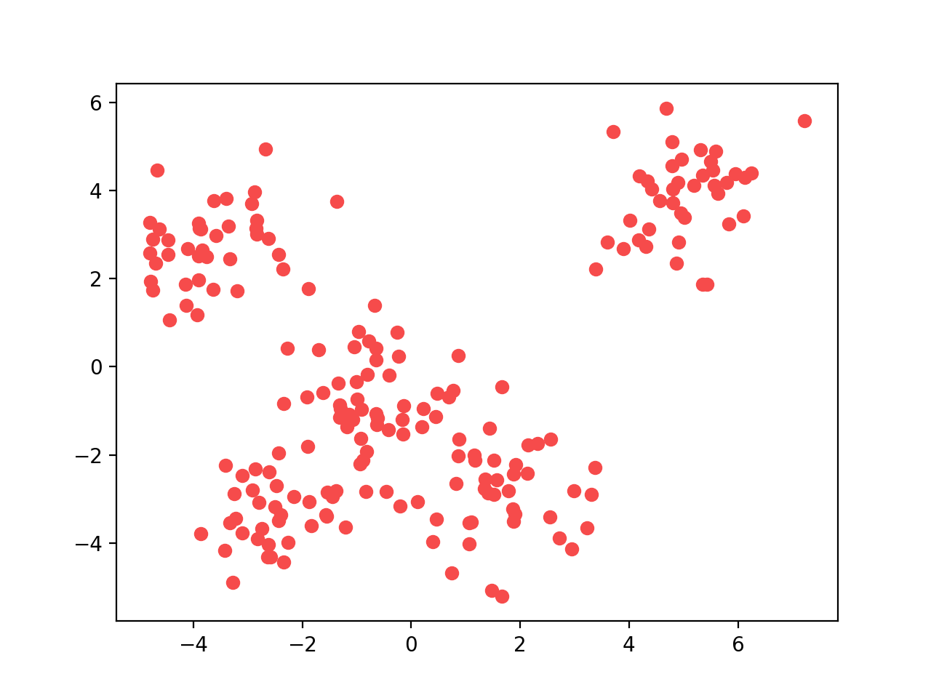
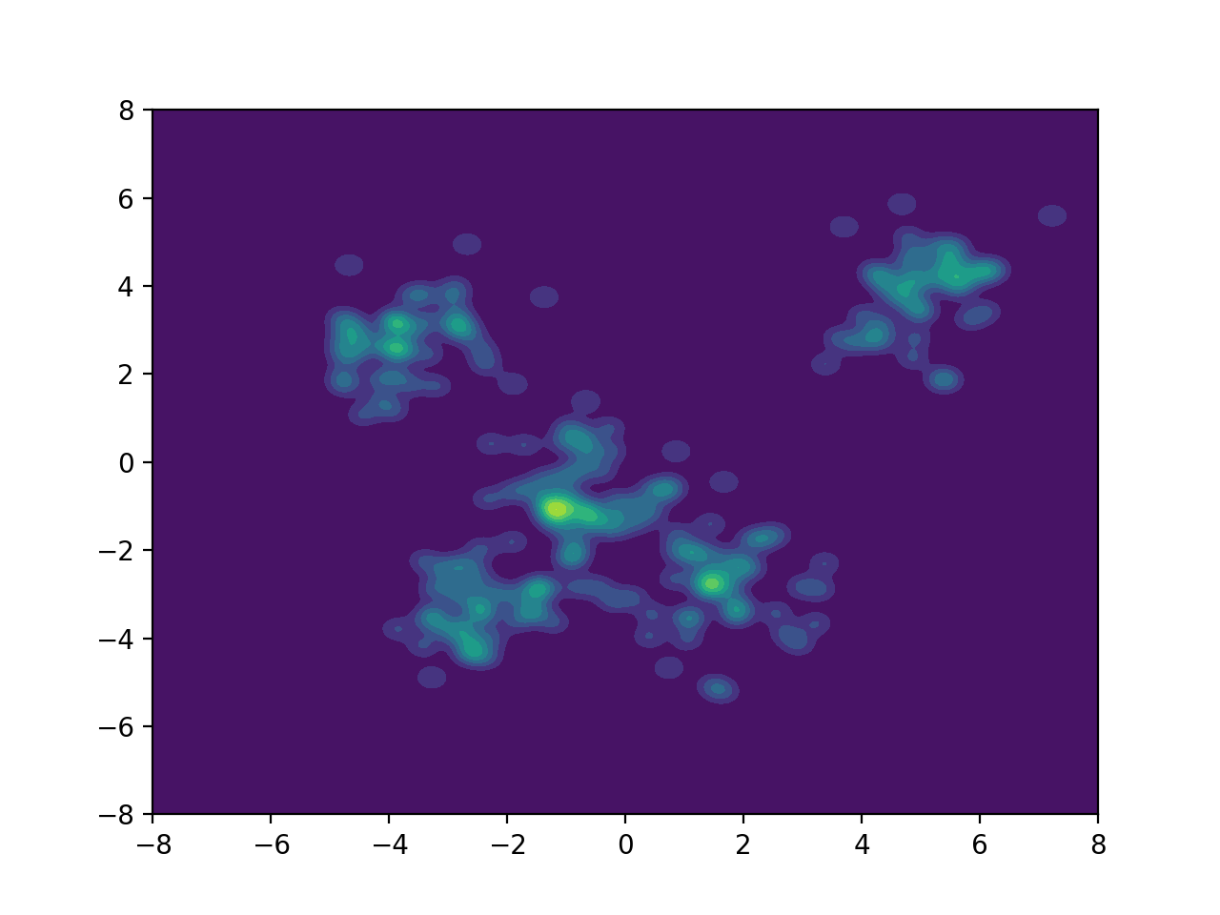
Loss function
We need a loss function that encourages the system to produce the desired mappings, without supervision
1
Distribution loss to encourage similarity of concept distributions between systems
Points from system A
KL divergence could be used, but for GMMs the approximation is expensive
Approximate by calculating negative log likelihood of points as a sample from GMM of another set of points
Problem: mode collapse
Mixture model using Gaussian kernel on system B

Slide 8
Loss function
We need a loss function that encourages the system to produce the desired mappings, without supervision from ground truth mappings
1
Distribution loss to encourage similarity of concept distributions between systems
KL divergence could be used, but for GMMs the approximation is expensive
Approximate by calculating negative log likelihood of points as a sample from GMM of another set of points
Problem: mode collapse

Slide 9
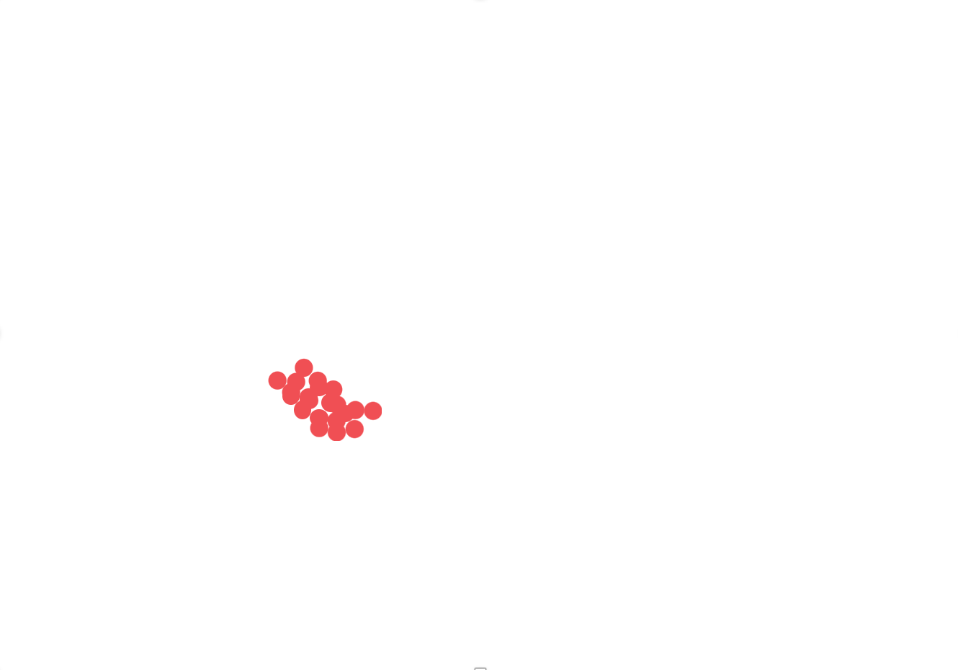
Loss function
We need a loss function that encourages the system to produce the desired mappings, without supervision from ground truth mappings
1
Distribution loss to encourage similarity of concept distributions between systems
KL divergence could be used, but for GMMs the approximation is expensive
Approximate by calculating negative log likelihood of points as a sample from GMM of another set of points
Problem: mode collapse

Slide 10
Loss function
We need a loss function that encourages the system to produce the desired mappings, without supervision from ground truth mappings
1
Distribution loss to encourage similarity of concept distributions between systems
Self loss (Euclidean distance)
A
A’
Model
2
Inputs from different conceptual systems
Error in mapping concepts back to themselves
B
B’
C
C’
From CycleGAN, Zhu et al (2018):
Self loss: mapping from and back into the same conceptual system, we want to reproduce the original point
Cycle consistency loss: if we map into a new system and back, we also want to retrieve the original point
Cycle loss (Euclidean distance)
A
A’
A_{b}’’
Model
Model
Inputs from different conceptual systems
B
B’
C
C’
What is this model?

Slide 11
Simple NNs
Approach
Problems
A simple Neural Network to learn a mapping from one system to another using the losses discussed
Have to train separate models for each system change
Struggles to get out of local minima for inputs of 5D +
Model for mapping from A → B
Model for mapping from B → A
Inputs from conceptual system A
Mapped to conceptual system B
Inputs from conceptual system B
Mapped to conceptual system A
N_{B} dimensions
N_{B} dimensions
N_{A} dimensions
N_{A} dimensions
N dimensions
N dimensions
…
…
…
…
…
…

Slide 12
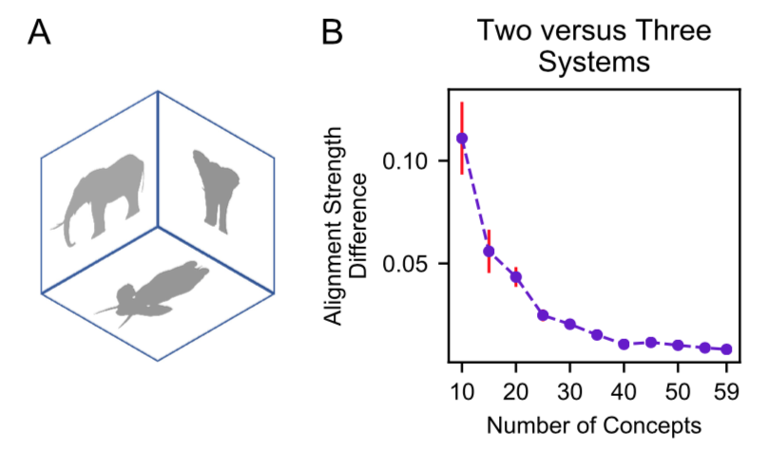
Shared latent space
Intuition
Approach
Leverage the structural information provided by taking all systems together
Semantic convergence zones in the brain
Simultaneously perform mapping for multiple systems
Train an encoder and decoder for each conceptual system into/from the same latent space
System A
System B
Encoder A
Encoder B
Decoder A
Z
(analogous to semantic convergence zones in ATL)
Decoder B
Encoder C
Decoder C
Roads & Love (2020)
System C
Notes:
Mention the psychological revelance of Z – ie that it could be related to the semantic convergence zone in the brain (ATL for semantic convergence zones, as in semantic memory; Perirhinal cortex specifically for integration of perceptual and conceptual features– Martin et al, 2018)

Slide 13
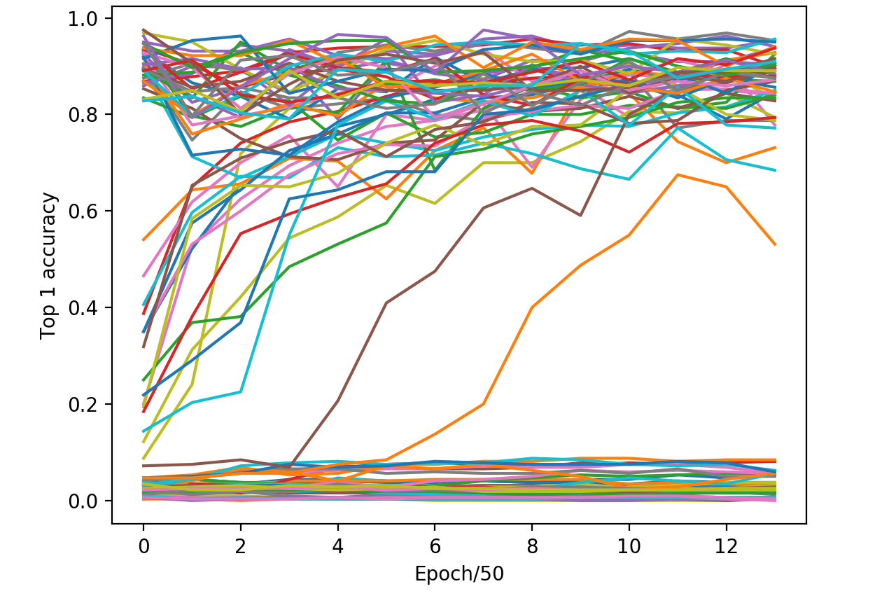
Preliminary results – 2 systems, 2D
Features of training:
Multiple runs
Batch steps in each epoch descending on self and cycle loss
Full steps in each epoch trained on distribution loss in latent space
For each system, p = 0.5 of initializing with best weights on next restart, otherwise initialize from scratch
2 systems:
System A
System B
Encoder A
Encoder B
Decoder A
Z
Decoder B
Mapping accuracy by run

Slide 14
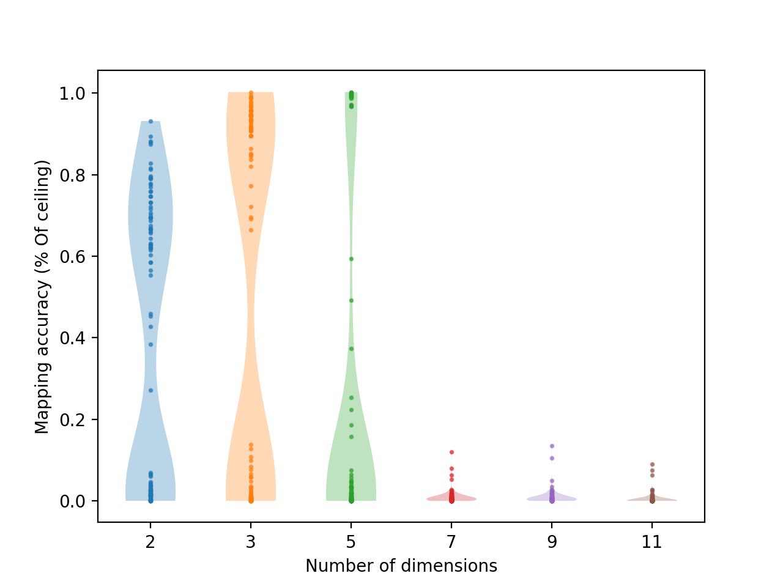

Preliminary results - 2 systems, more dimensions
Features of training:
Multiple runs
Batch steps in each epoch descending on self and cycle loss
Full steps in each epoch trained on distribution loss in latent space
For each system, p = 0.5 of initializing with best weights on next restart, otherwise initialize from scratch
2 systems:
System A
System B
Encoder A
Encoder B
Decoder A
Z
Decoder B
Mapping accuracy achieved by each run
Noise $σ$ = 0.01

Slide 15
Next steps
System A
System B
3 systems:
Encoder A
Encoder B
Selective optimization of poorest performing encoder/decoder pairs to encourage semantic convergence
Decoder A
Z
Decoder B
Encoder C
Decoder C
System C

Slide 16
Next steps
Test system response to varying levels of noise and different amounts of distribution ‘clumpiness’
Test with different amounts of concept overlap between systems
Explore best handling of conceptual systems with different dimensionalities

Slide 17

What I’ve learned
Systematic approaches to computational modelling, including:
The effective use of synthetic problems
The perils of overcomplicating things
Practical skills in TensorFlow:
Custom models and layers
Custom training
Ways to maximise efficiency
A new approach to ML/cognition interface:
Exploring mechanisms for a known cognitive phenomenon using ML modelling
Model which aims to address the impact of a noisy real world

Slide 18
Thanks for listening!

Slide 19
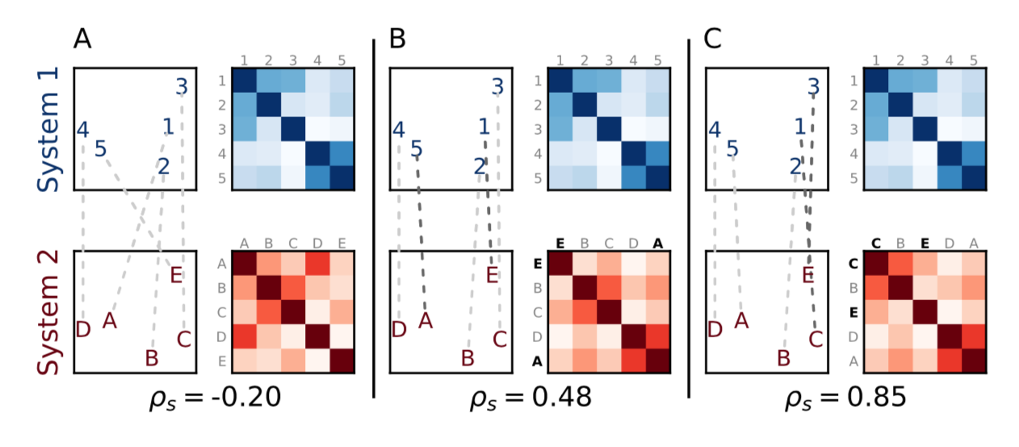
Alignment correlation figure
*Spearman correlation between upper diagonals of similarity matrices. Item order in similarity matrices determined by mapping
Roads and Love (2020)

Slide 20
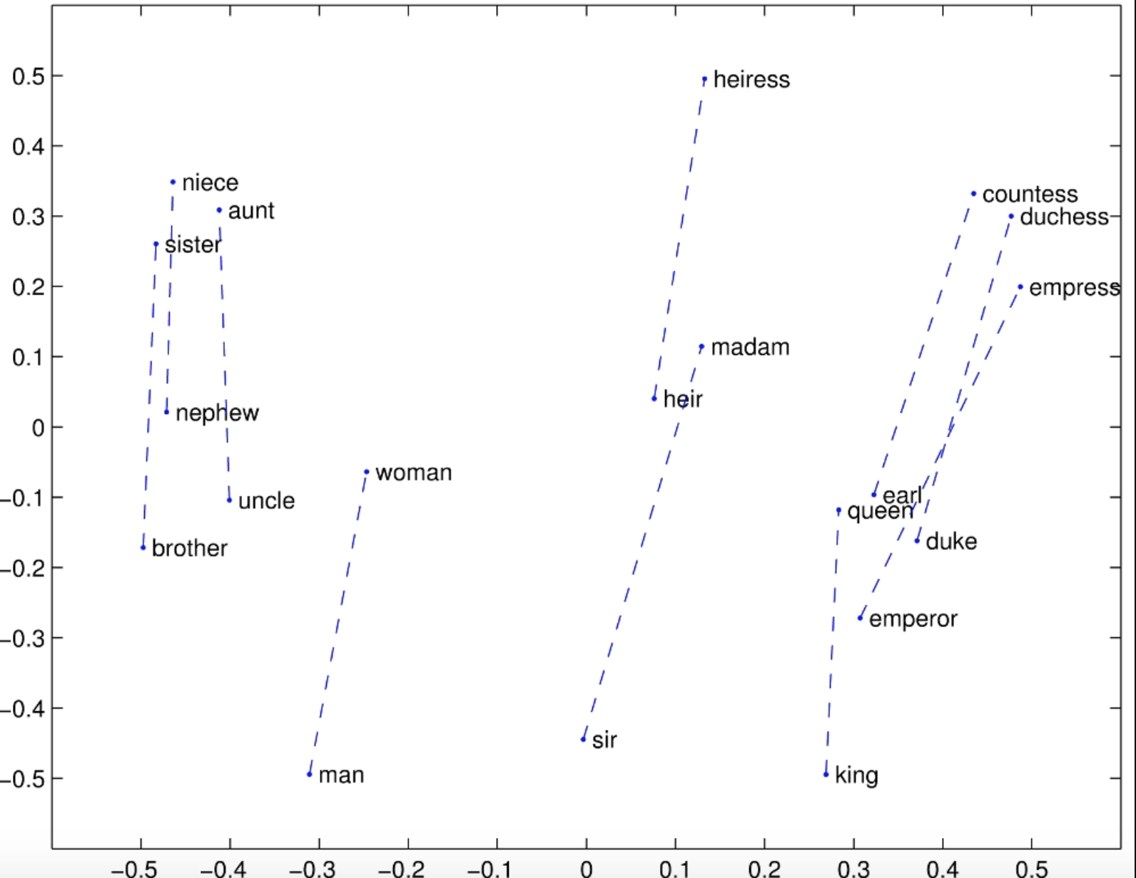
Use of embeddings
Embeddings for different conceptual systems (image, text, audio) derived based on co-occurrence statistics
Pre-trained 300-D text embeddings; image and audio embeddings derived using the GloVe algorithm applied to image/audio corpora
Pennington, Socher, and Manning (2014)
Roads and Love (2020)

Slide 21
What should this model look like?
Simple neural network
Align one system with another using transition-specific model
Neural network with clustering
Use information from different levels of clustering to guide alignment with a simple NN
Neural network with shared latent space
Aim to take advantage of the shared underlying structure of different systems by encouraging the network to
Graph-based neural network
Construct graphs connecting concepts N nearest-neighbours
Use convolutions to extract hierarchical graph structure
Use within and between graph attention to optimize mapping
Simple neural network
Align one system with another using transition-specific model
Neural network with clustering
Use information from different levels of clustering to guide alignment with a simple NN
Neural network with shared latent space
Aim to take advantage of the shared underlying structure of different systems by encouraging the network to
Graph-based neural network
Construct graphs connecting concepts N nearest-neighbours
Use convolutions to extract hierarchical graph structure
Use within and between graph attention to optimize mapping

Slide 22
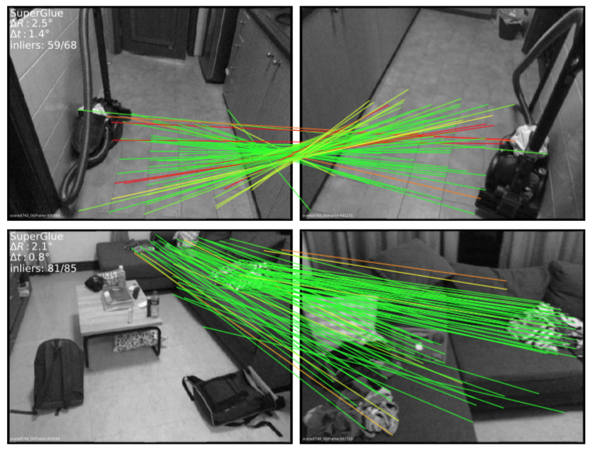
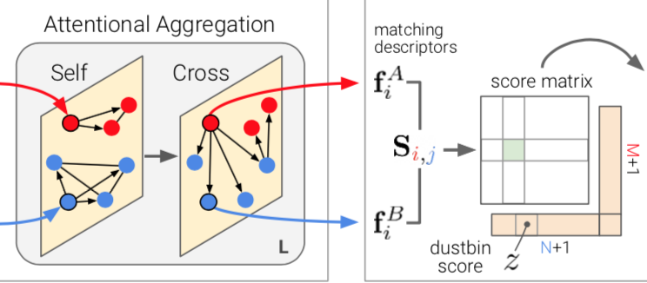
Ideas from SuperGlue
Original system
Adapted Approach
Problems
Finds correspondences between points in pairs of images, eg photos taken from different viewpoints
Potential to identify similar points between conceptual systems using cross and self-attention
Feature information to accompany embeddings is not rich enough (e,g word frequencies or graph features)
Inefficient (Sinkhorn Algorithm)
SuperGlue, Sarlin et al, 2019

